Slide 1

DDS Attrition Analysis
Team DataTex

Slide 2

Introduction
DDSAnalytics: Using Data to Solve Problems
Solutions for Fortune 1000 Companies
Workforce Planning
Employee Training Program
Identifying High-Potential Employees
Reducing Turnover
Data Interpretation
Notes:
DDSAnalytics is a Data Analytics company that reviews company data to provide insights and offer solutions.

Slide 3
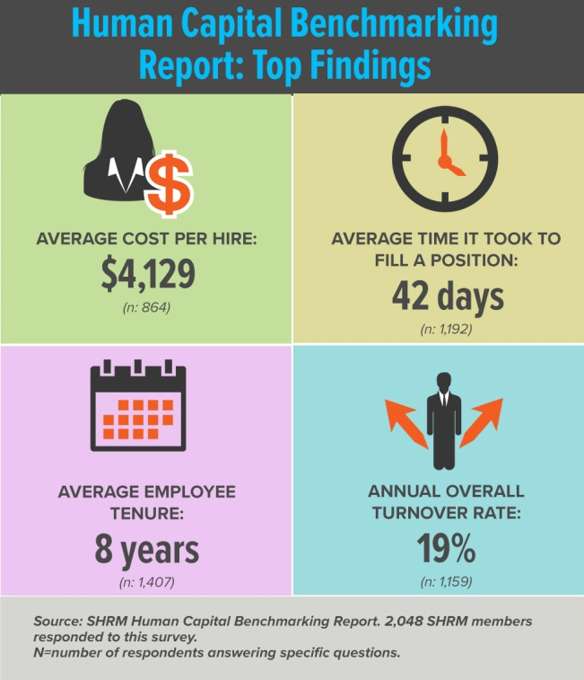

Cost of Attrition - 2016
Costs Per Hire $4,129
Time to Fill 42 days
Employee Tenure 8 Years
Annual Turnover Rate 19%
Notes:
Currently ACME’s Employee Tenure is estimated at 7 Years and Annual Turnover Rate at 16%

Slide 4
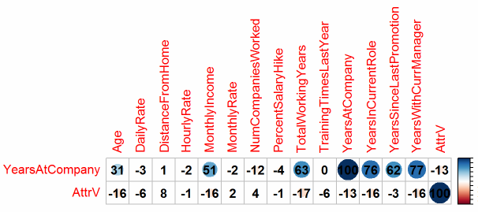
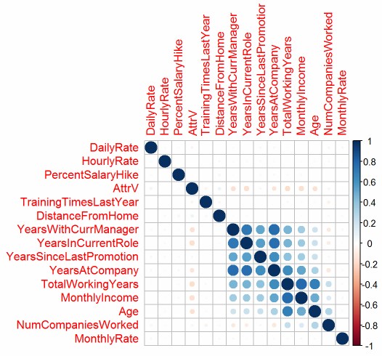
Exploratory Data Analysis
Exclusion of Unnecessary Variables
"Standard Hours", "Over 18“, "Employee Count”, etc.
Preliminary Correlation Tests
Correlation Tests of Continuous Variables

Slide 5
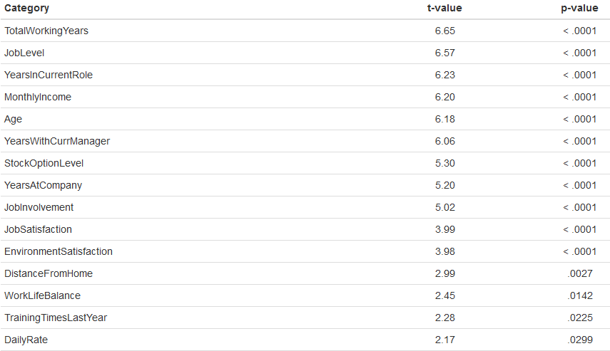
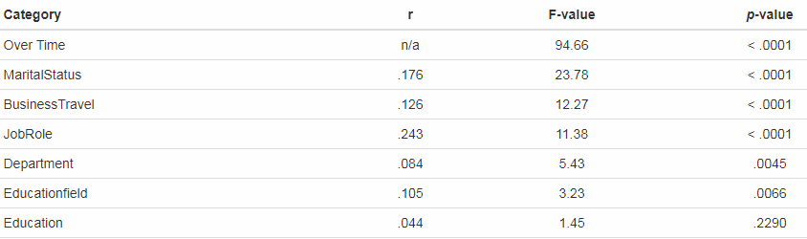
Analysis of Significance
t-tests for significance of distributions
ANOVA for Analysis of Categorical Variance

Slide 6
Preliminary Variable Selection
Based on the Exploratory Analysis the Following Variables Emerged as

Slide 7
Naïve-Bayse

Slide 8
Backward Selection

Slide 9
Logistic Regression

Slide 10
Other Findings

Slide 11
Conclusions
Top 3 Factors that Contribute to Turnover

